Slide 1
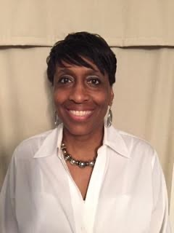
COURSE SELECTION PRE-REGISTRATION 2023 RISING 10TH GRADE (NON-IB STUDENTS)
Germantown High School – updated February 22, 2023
Ms. Lee (10th Grade Counselor)

Slide 2
GRADE LEVEL ADMINISTRATORS
9th Grade – Mr. Longino
10th Grade - Ms. Thomas/Dr. Payne
11th Grade – Dr. Gore
12th Grade – Ms. Fayne

Slide 3
GRADE LEVEL COUNSELORS
9th Grade - Ms. Clemmensen
10th Grade - Ms. Lee
11th Grade – Dr. Willingham
12th Grade - Ms. Odom
College & Career - Ms. Norman
IB Counselor – Ms. Morris

Slide 4
TN GRADUATION REQUIREMENTS
Subject | Credits | Required Classes
English | 4 | English I, II, III, IV
Math | 4 | Algebra I, Geometry, Algebra II, and a Senior Math class
Science | 3 | Lab Science, Biology I, Chemistry or Physics, or an equivalent class
Social Studies | 3.5 | World History/Geo., Personal Finance, US History & Economics/US Gov’t
Wellness/PE | 1.5 | Lifetime Wellness and Lifetime Sports or AJROTC I and II
World Lang | 2 | Same Language
Fine Arts | 1 | Visual Art, Choir, Band, Orchestra, Theater, or similar class
Elective Focus | 3 | In the same career/vocational area
TOTAL: | 22 | CORE CREDITS, a passing Civics Test score and an ACT score to graduate

Slide 5
MSCS PROMOTION REQUIREMENTS
10th grade
11th grade
12th grade
To be promoted to a sophomore:
You must earn a minimum of five (5) credits, including
English 9
To be promoted to a junior:
You must earn a minimum of eleven (11) credits, including
English 9 and English 10
To be promoted to a senior:
You must earn a minimum of sixteen (16) credits, including
English 9, English 10, and English 11

Slide 6
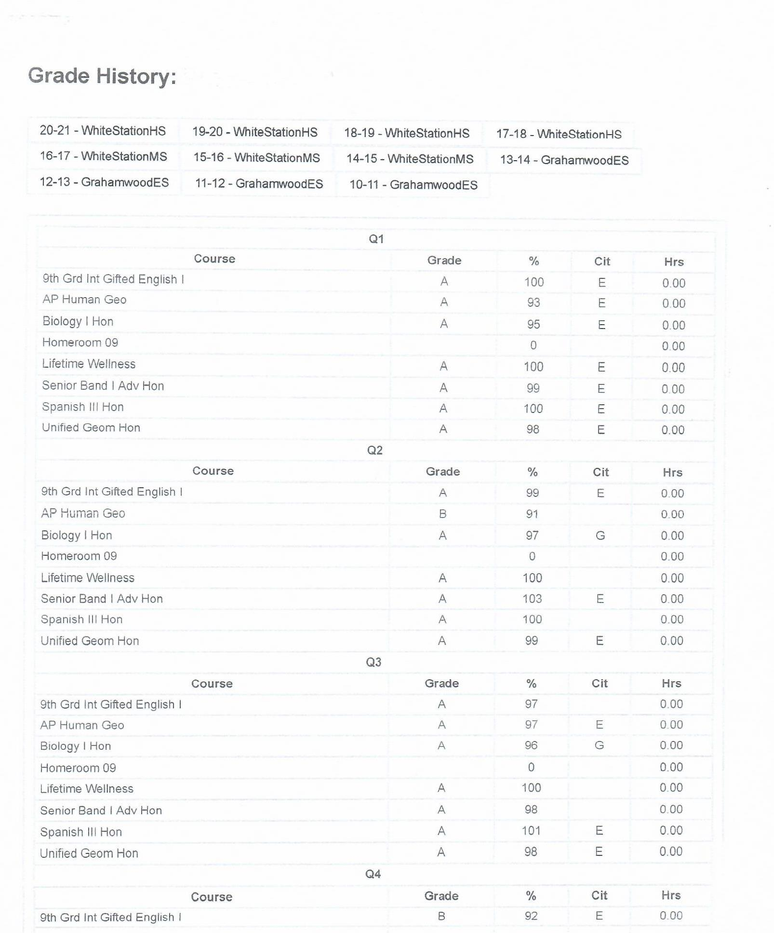
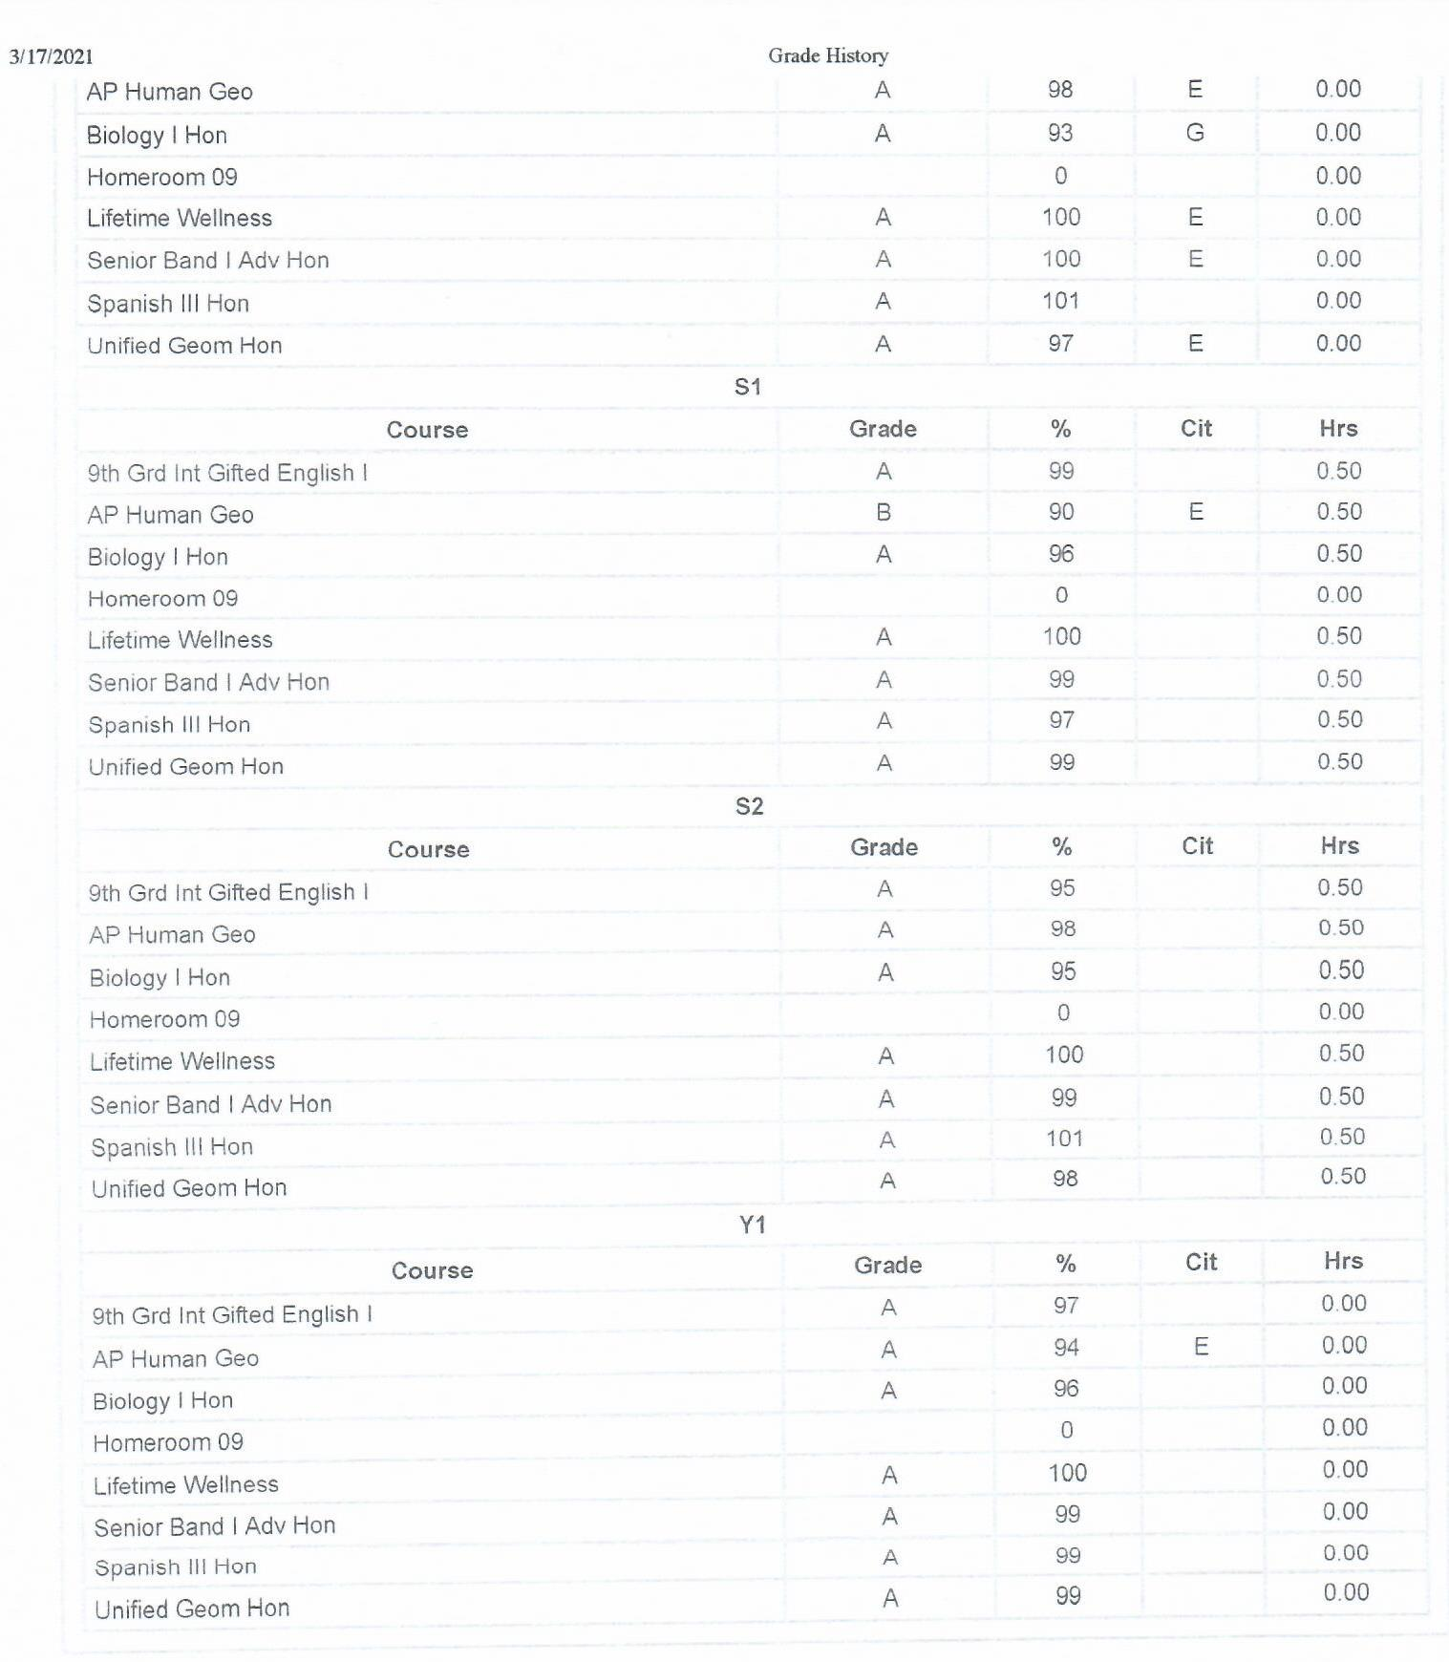
POWERSCHOOL – GRADE HISTORY

Slide 7
GHS - HONORS/AP POLICY
Must earn a 90% or higher each semester in their standard-level class for the subject area to qualify for honors
Must have good conduct and attendance in school
Must earn an 80% or higher each semester in their honors-level class for the subject area to remain in honors
Or identified by the district as a candidate for honors-level classes (parents must opt-out in PowerSchool and return an opt-out letter to your grade-level Counselor or you will be auto-enrolled in honors)

Slide 8
GHS CCTE/ELECTIVE FOCUS AREAS
Automotive Maintenance & Light Repair
Construction Engineering - Wood Work
Early Childhood Education - Teaching
Health Science - Sports Performance
Cosmetology - ($250 kit fee)
Army Junior Reserve Officer’s Training Corps
Fine Arts - Choir, Band, Orchestra, Theater, etc.
Advanced Placement - AP Classes
Criminal Justice - Policing
Entrepreneurship - Small Business
Marketing Mgnt - Sales/Advertising
Supply Chain Mgnt – Product Flow
Office Management
Business Management
Audio/Visual - TV Production
Dietetics and Nutrition
Cybersecurity – Computers/Coding
Humanities/Liberal Arts - Psychology, Sociology, Literature, Mythology, etc.

Slide 9
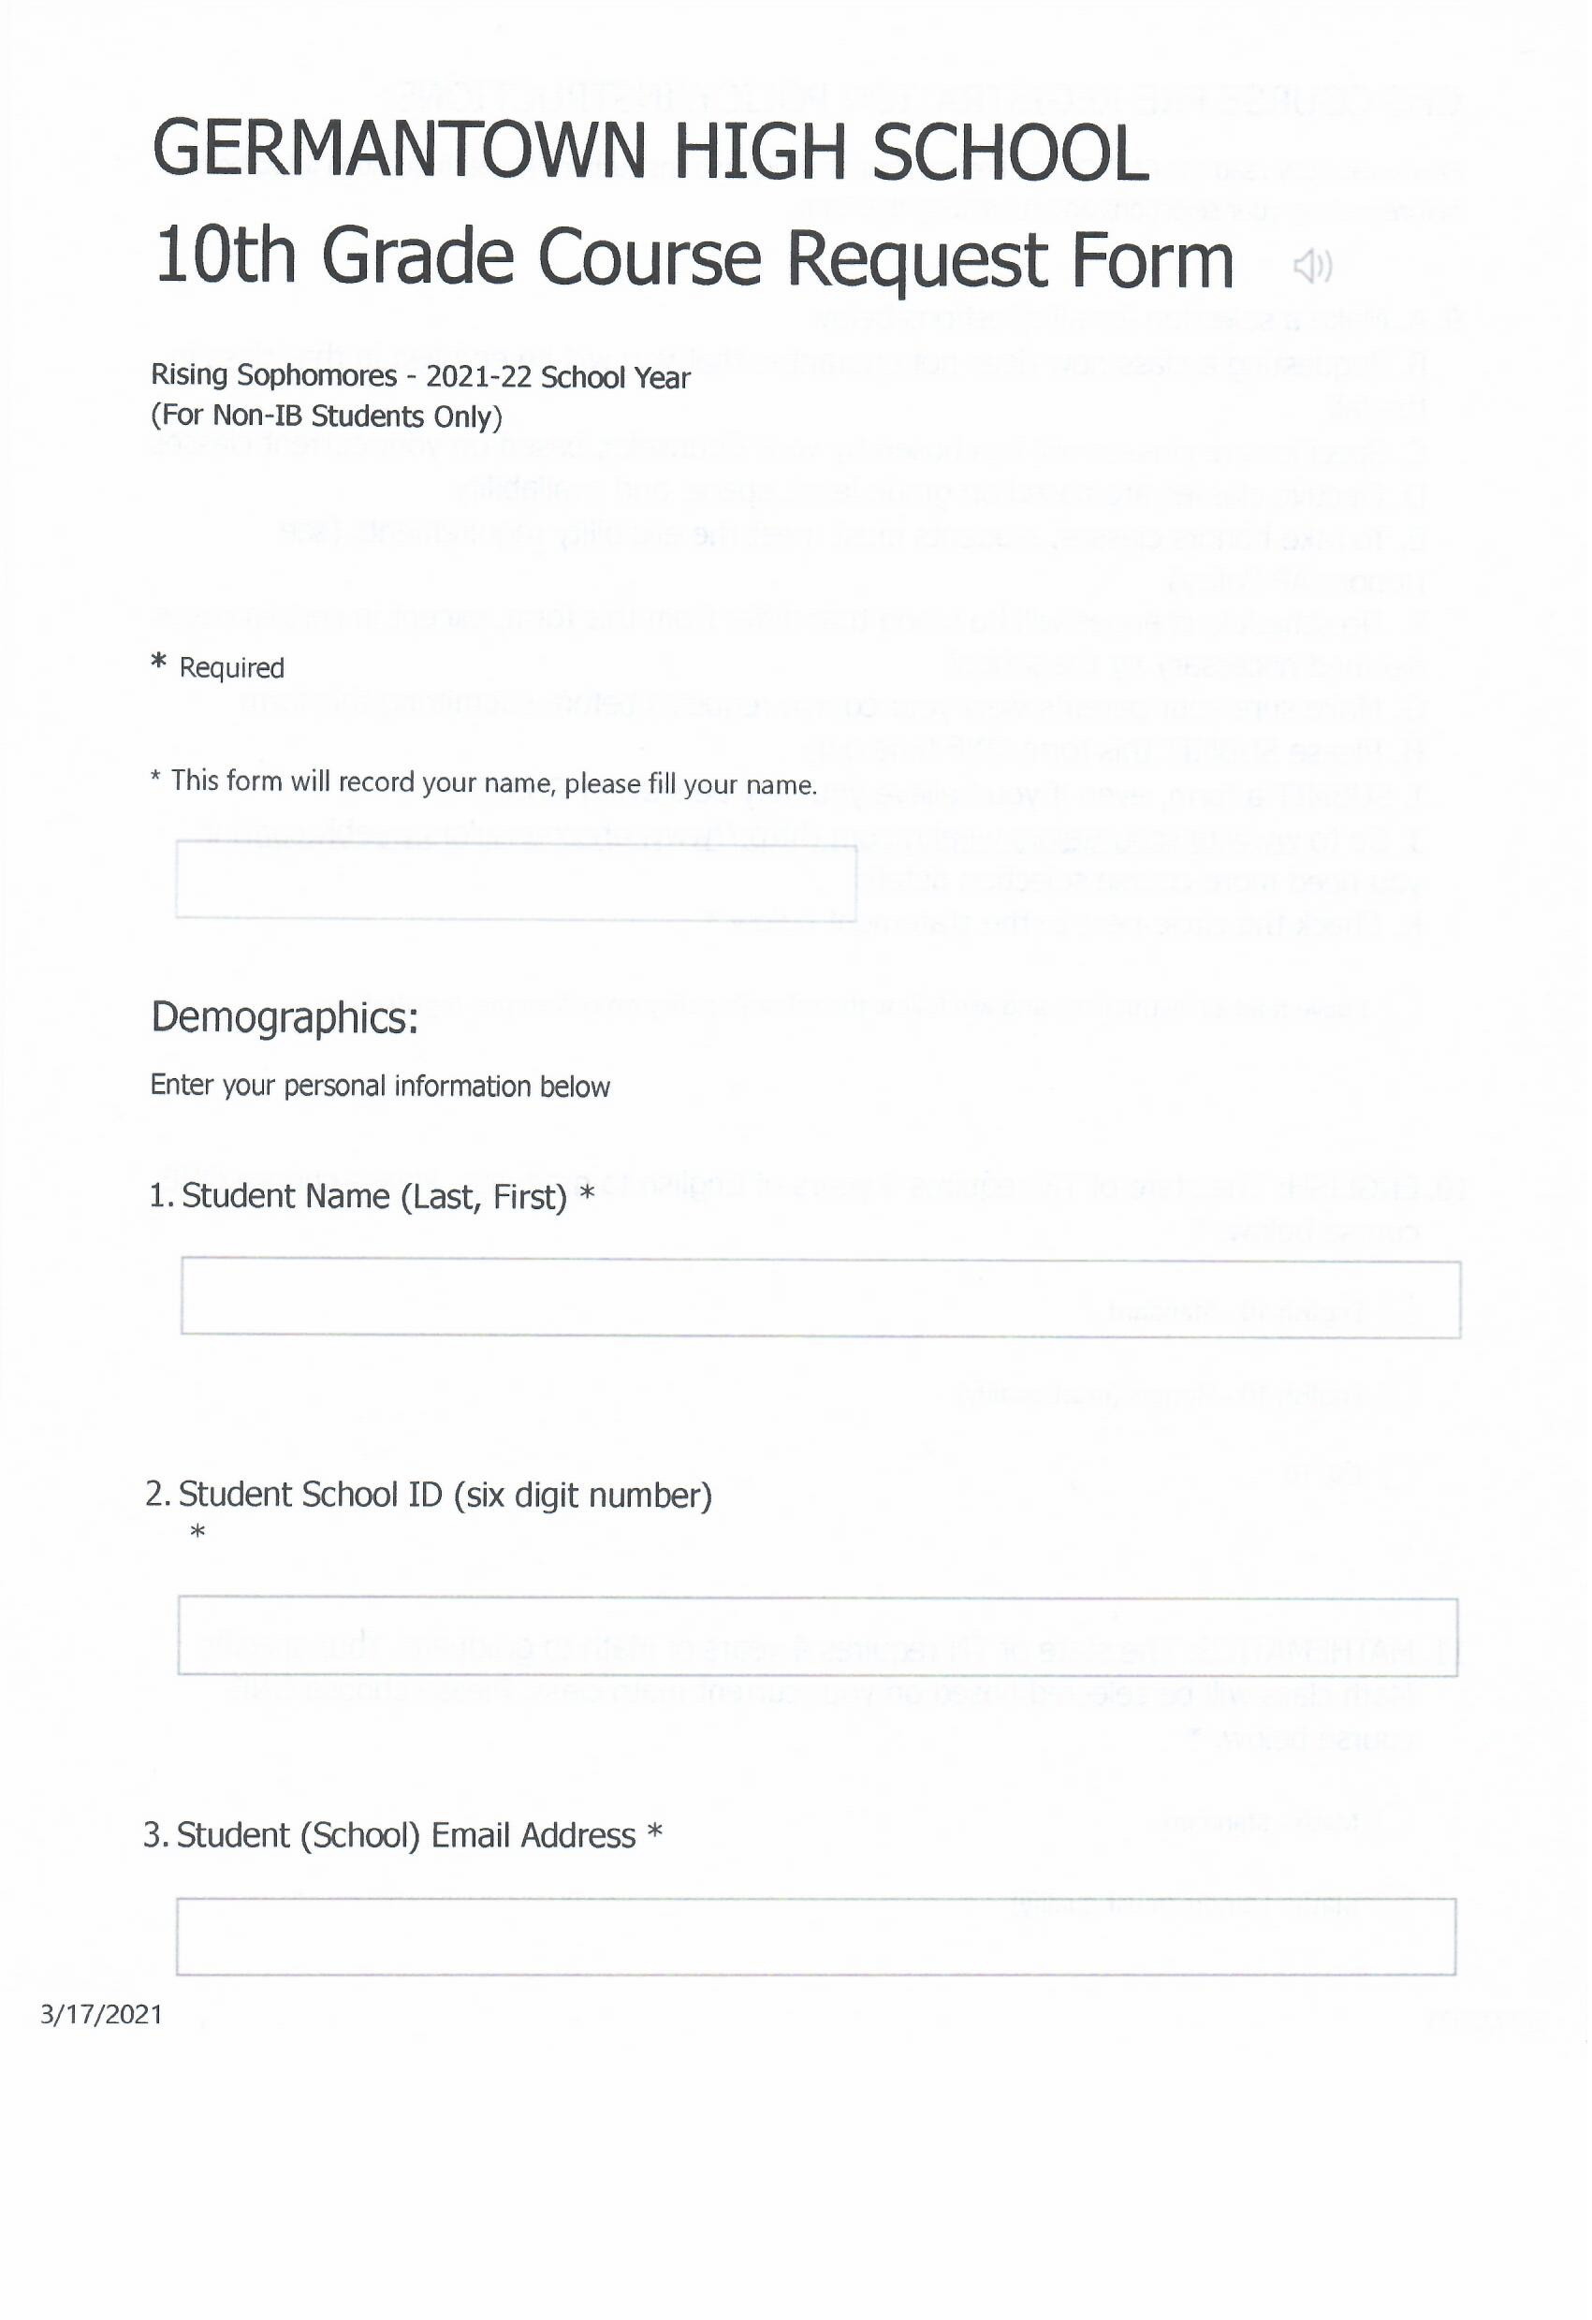
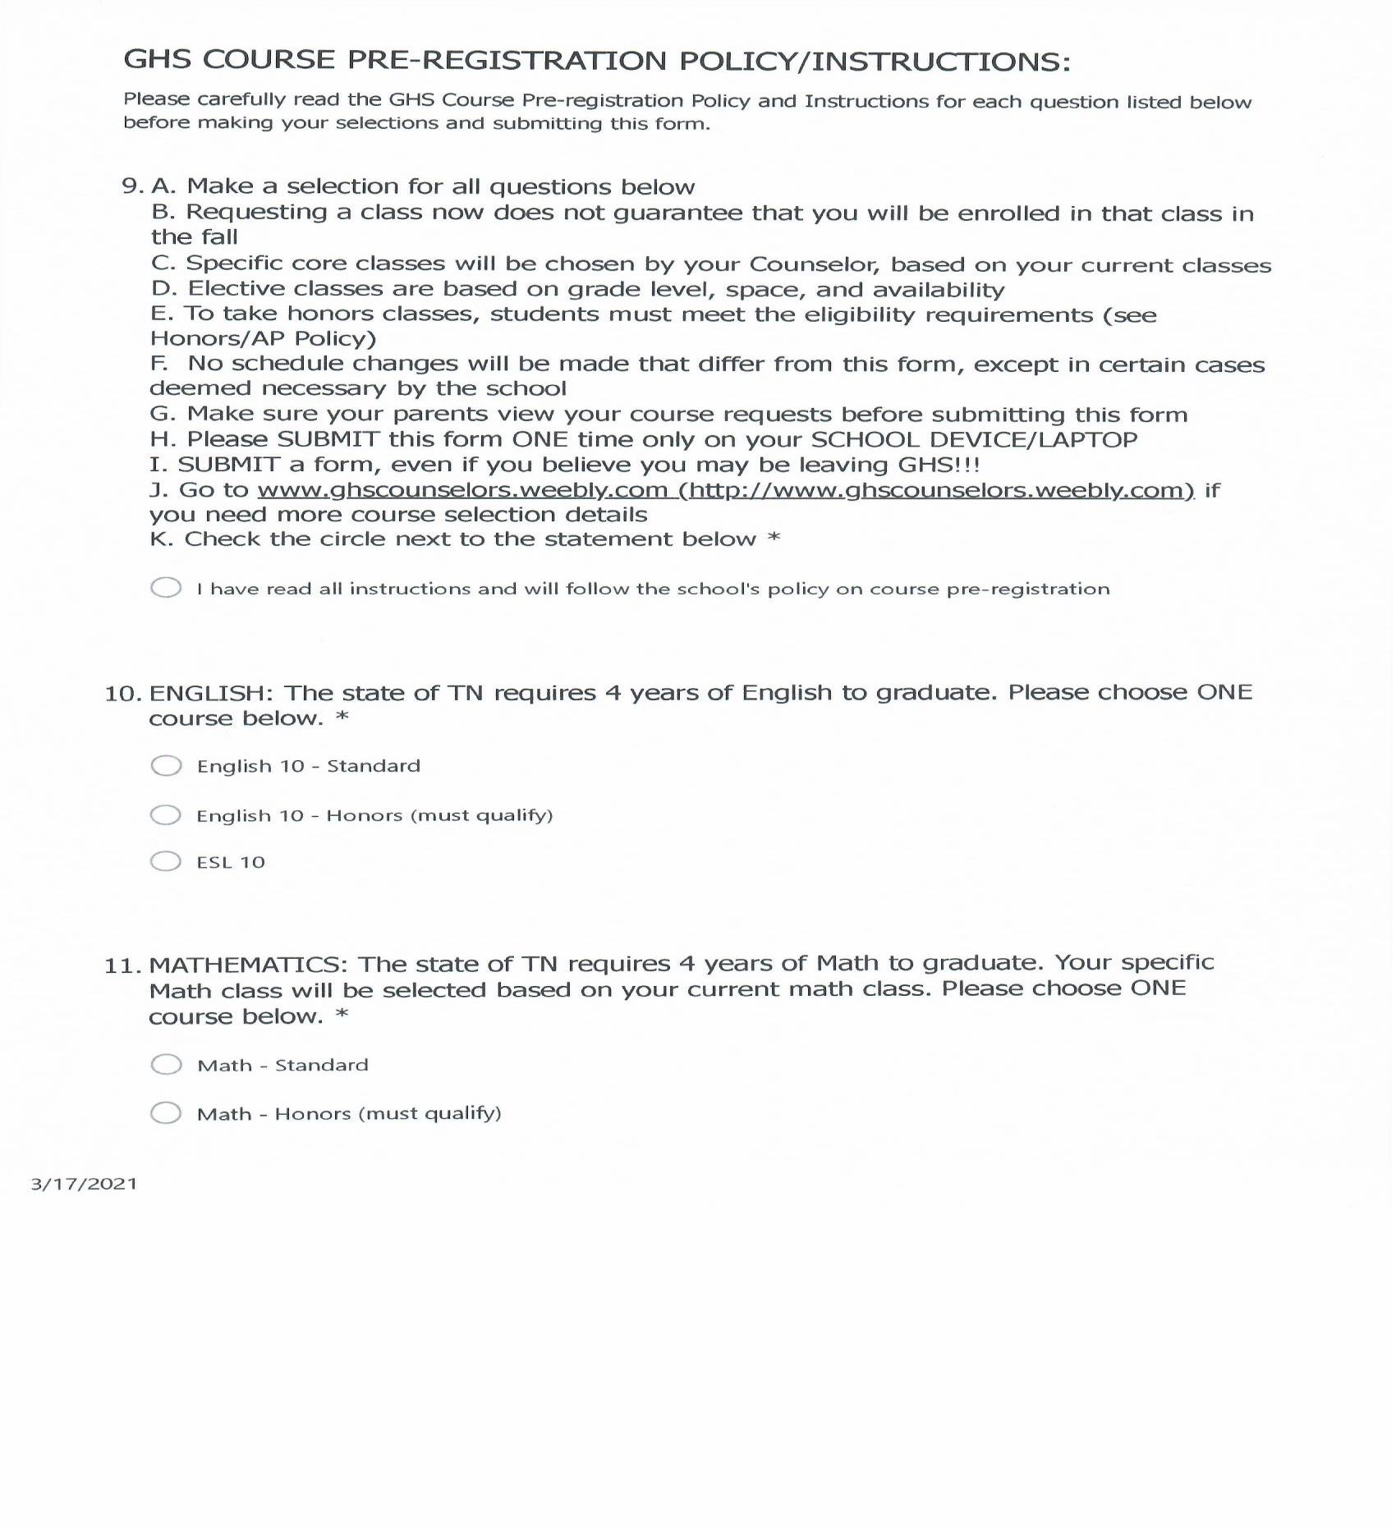
GHS COURSE PRE-REGISTRATION FORM

Slide 10
March 20, 2023 at 2:15pm is the Deadline to Submit your Form
Make sure you submit your course pre-registration form on your SCHOOL DEVICE (if possible) and with a parent signature!!!

Slide 11
HOW TO CONTACT YOUR COUNSELOR
Ms. Clemmensen (9th Grade)
ClemmensenRK@scsk12.org
Guidance Office Number
(901) 416-2302

Slide 12
Go Red Devils!!!
RISING SOPHOMORES
COMPLETE THIS FORM WITH YOUR PARENT!!!
LINK FOR COURSE PRE-REGISTRATION FORM:
https://forms.office.com/r/sQVYZLW03H

